Slide 1
CLZZ Presents: Pathing Innovation

Slide 2
1
Introduction
Team
Project Overview

Slide 3
Team CLZZ
Anhua Chen,
Masters Program in Computational Social Science, Second Year
Xiang Zhang,
Masters Program in Computational Social Science, Second Year
Xiuyuan Zhang:
Masters Program in Computational Social Science, Second Year
David Liu:
BA in Economics with Spec. in Business, Second Year

Slide 4
Project Goal
Analyzes patterns in U.S. patent citations since 1976
Focuses on how innovation networks shift across sub-industries over time
Identifies shortest paths between patents in a large network structure

Slide 5
Broad Objective
How does innovation in certain sub-industries affect broader economic development?

Slide 6
Objectives
Merge large datasets using MapReduce and scale the process on Google Cloud Services (GCS)
Identify differences in infrastructure between the local machine and GCS
Modify code for compatibility with GCS
Develop a Dijkstra algorithm of scalable processing power
Identify how to parallelize a local-machine-based Dijkstra algorithm
Modify code for compatibility with GCS

Slide 7
Big Data Pre-processing
USPTO Citation Data
NBER Datasets

Slide 8
Datasets
U.S. Patent Citations
Size: 98,207,057 rows 3.505 GB
Description: Each row represents a unique citation
Key Columns: uuid, date patent_id, citation_id
NBER Patent Classifications
Size: 5,105,937 rows 110.807 MB
Description: Each row represents a unique patent
Key Columns: patent_id, category_id, subcategory_id
NBER Industry Subcategories
Size: 37 rows 871 bytes
Description: Each row represents an id-name pair
Key Columns: id, name

Slide 9
Data Preprocessing
NBER Industry Subcategories
( industry_code , industry_name )
NBER Patent Classifications
( patent_id, industry_code )
Patent-Industry Pair
( patent_id, industry_name )
U.S. Patent Citations
(citing_patent_id, cited_patent_id)
Final Data
(citing_patent_id, cited_patent_id,
citing_industry_name, cited_industry_name)

Slide 10
Preprocessing: First Merge
(a, b) NBER Industry Data
(a, c, d) Patent Data
Mapper
(a, *, c, d)
(a, b, *, *)
Sorter (automatic with local)
(a, b, *, *)
(a, *, c, d)
Reducer
(a, b, c, d) Patent-Industry Pair

Slide 11
Preprocessing: Second Merge
(a, b) Patent-Industry Pair
(a₁, a₂, c, d) Citation Data
Mapper
(a₁, *, c, d)
(a₂, *, c, d)
(a, b, *, *)
Sorter (automatic with local)
(a, b, *, *)
(a₁, *, c, d)
(a₂, *, c, d)
First Reducer
(a₁, b₁, c, d)
(a₂, b₁, c, d)
Second Reducer
(a₁, a₂, b₁, b₁, c, d) Final Data

Slide 12
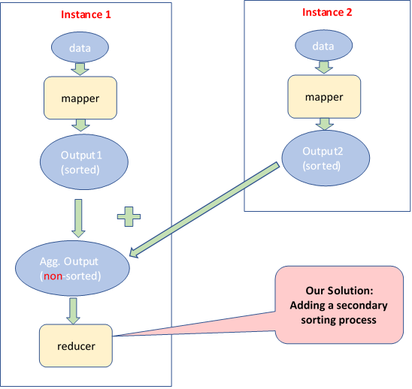
Data Preprocessing: Local to GCS

Slide 13
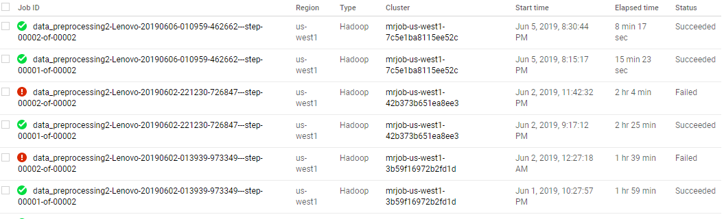
Data Preprocessing: Local to GCS

Slide 14
Preliminary Results on Cross-Industry Citation Patterns over time

Slide 15
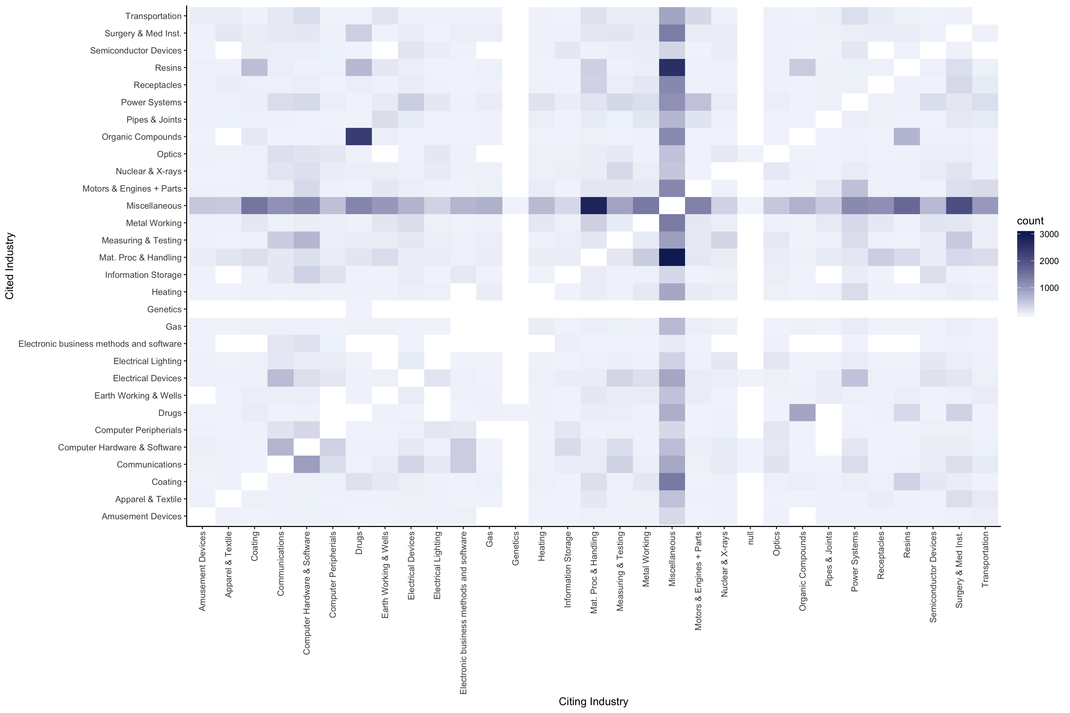
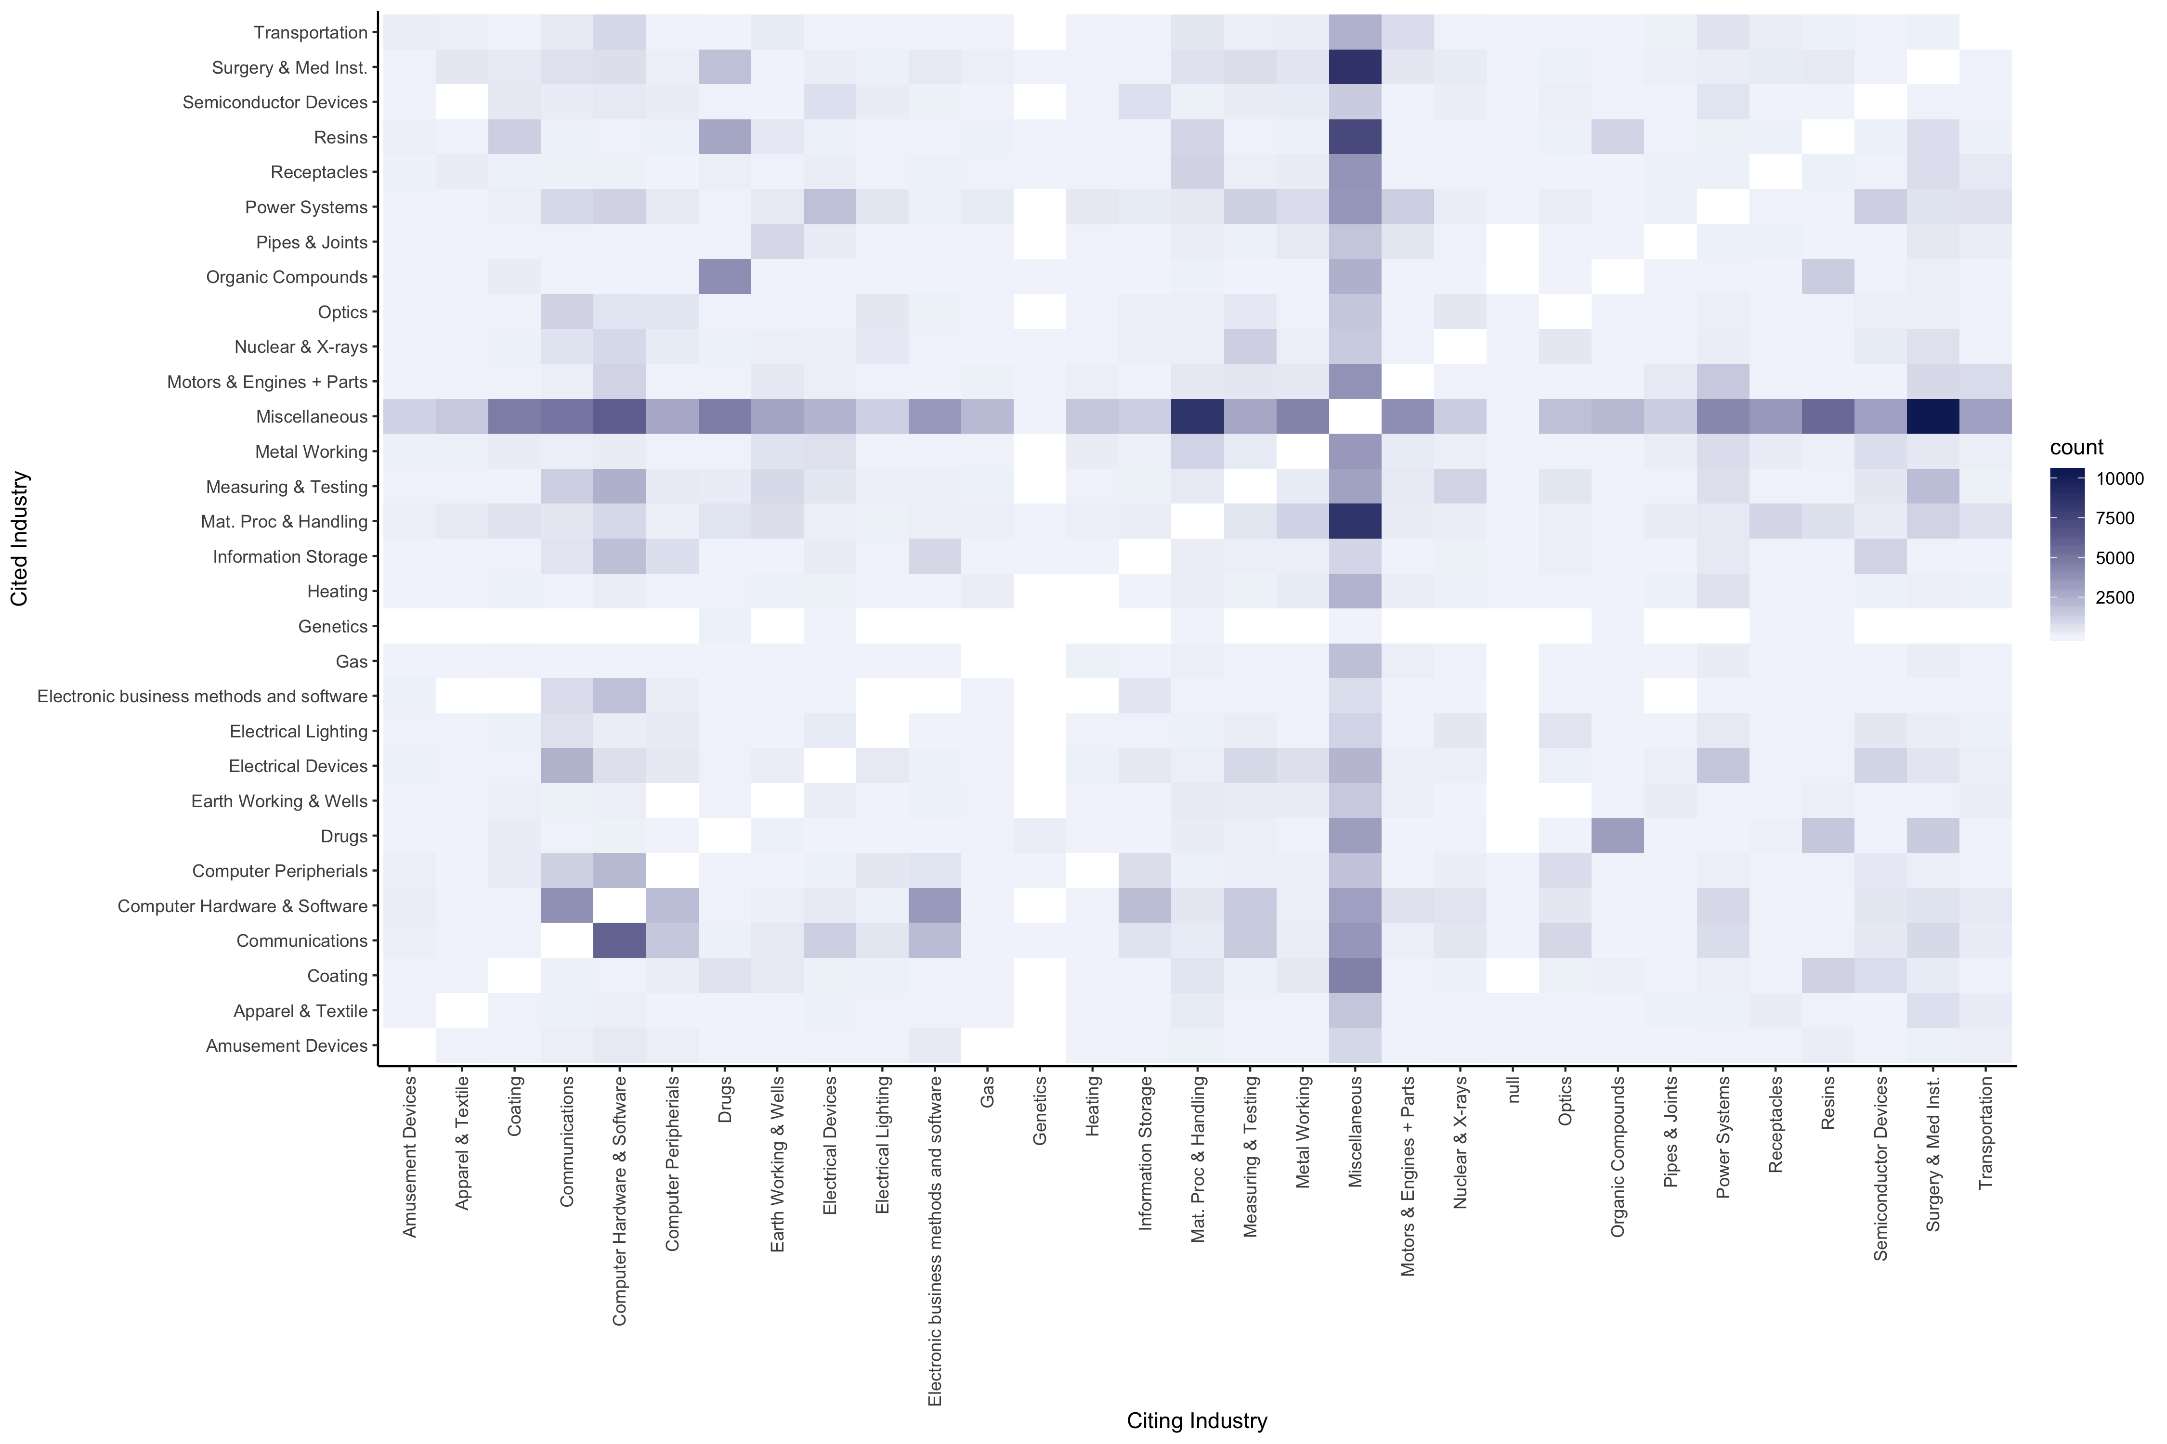
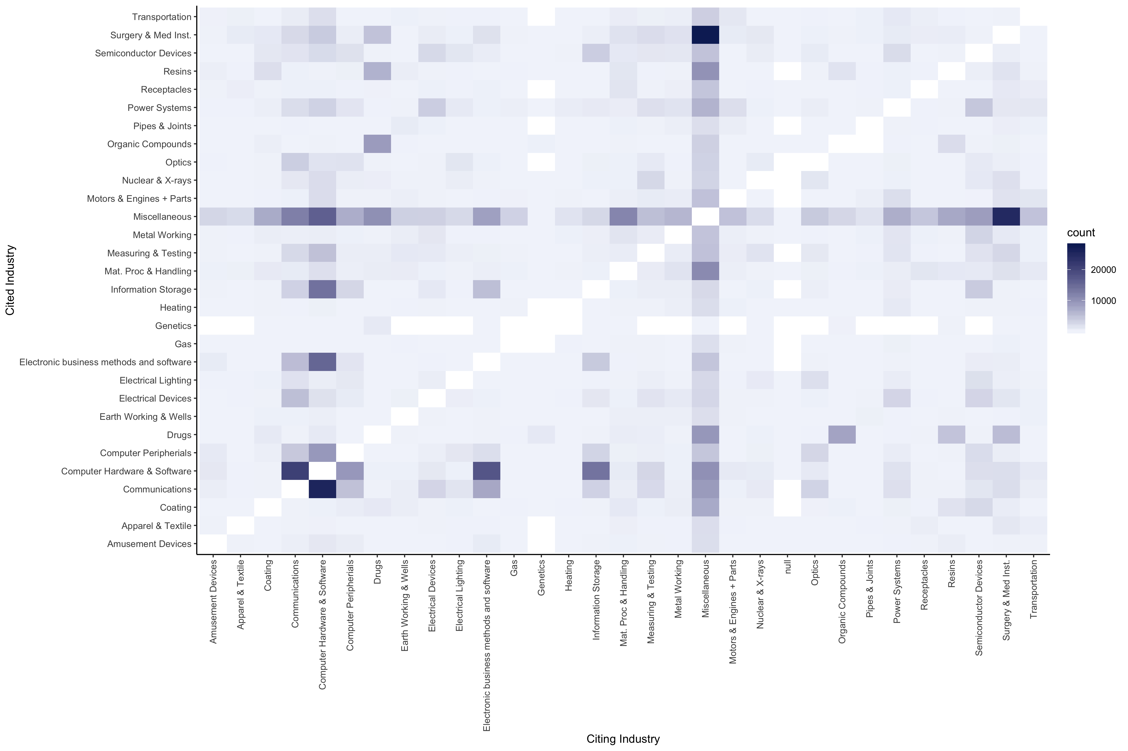
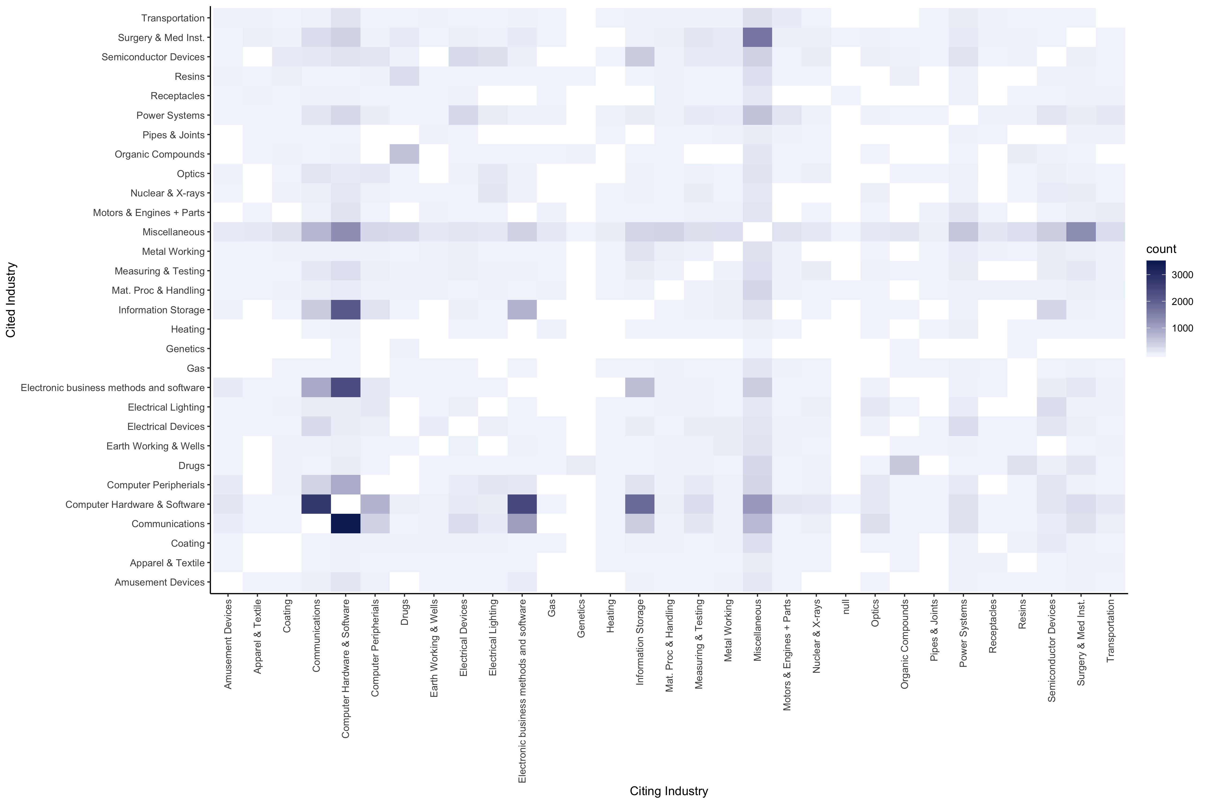
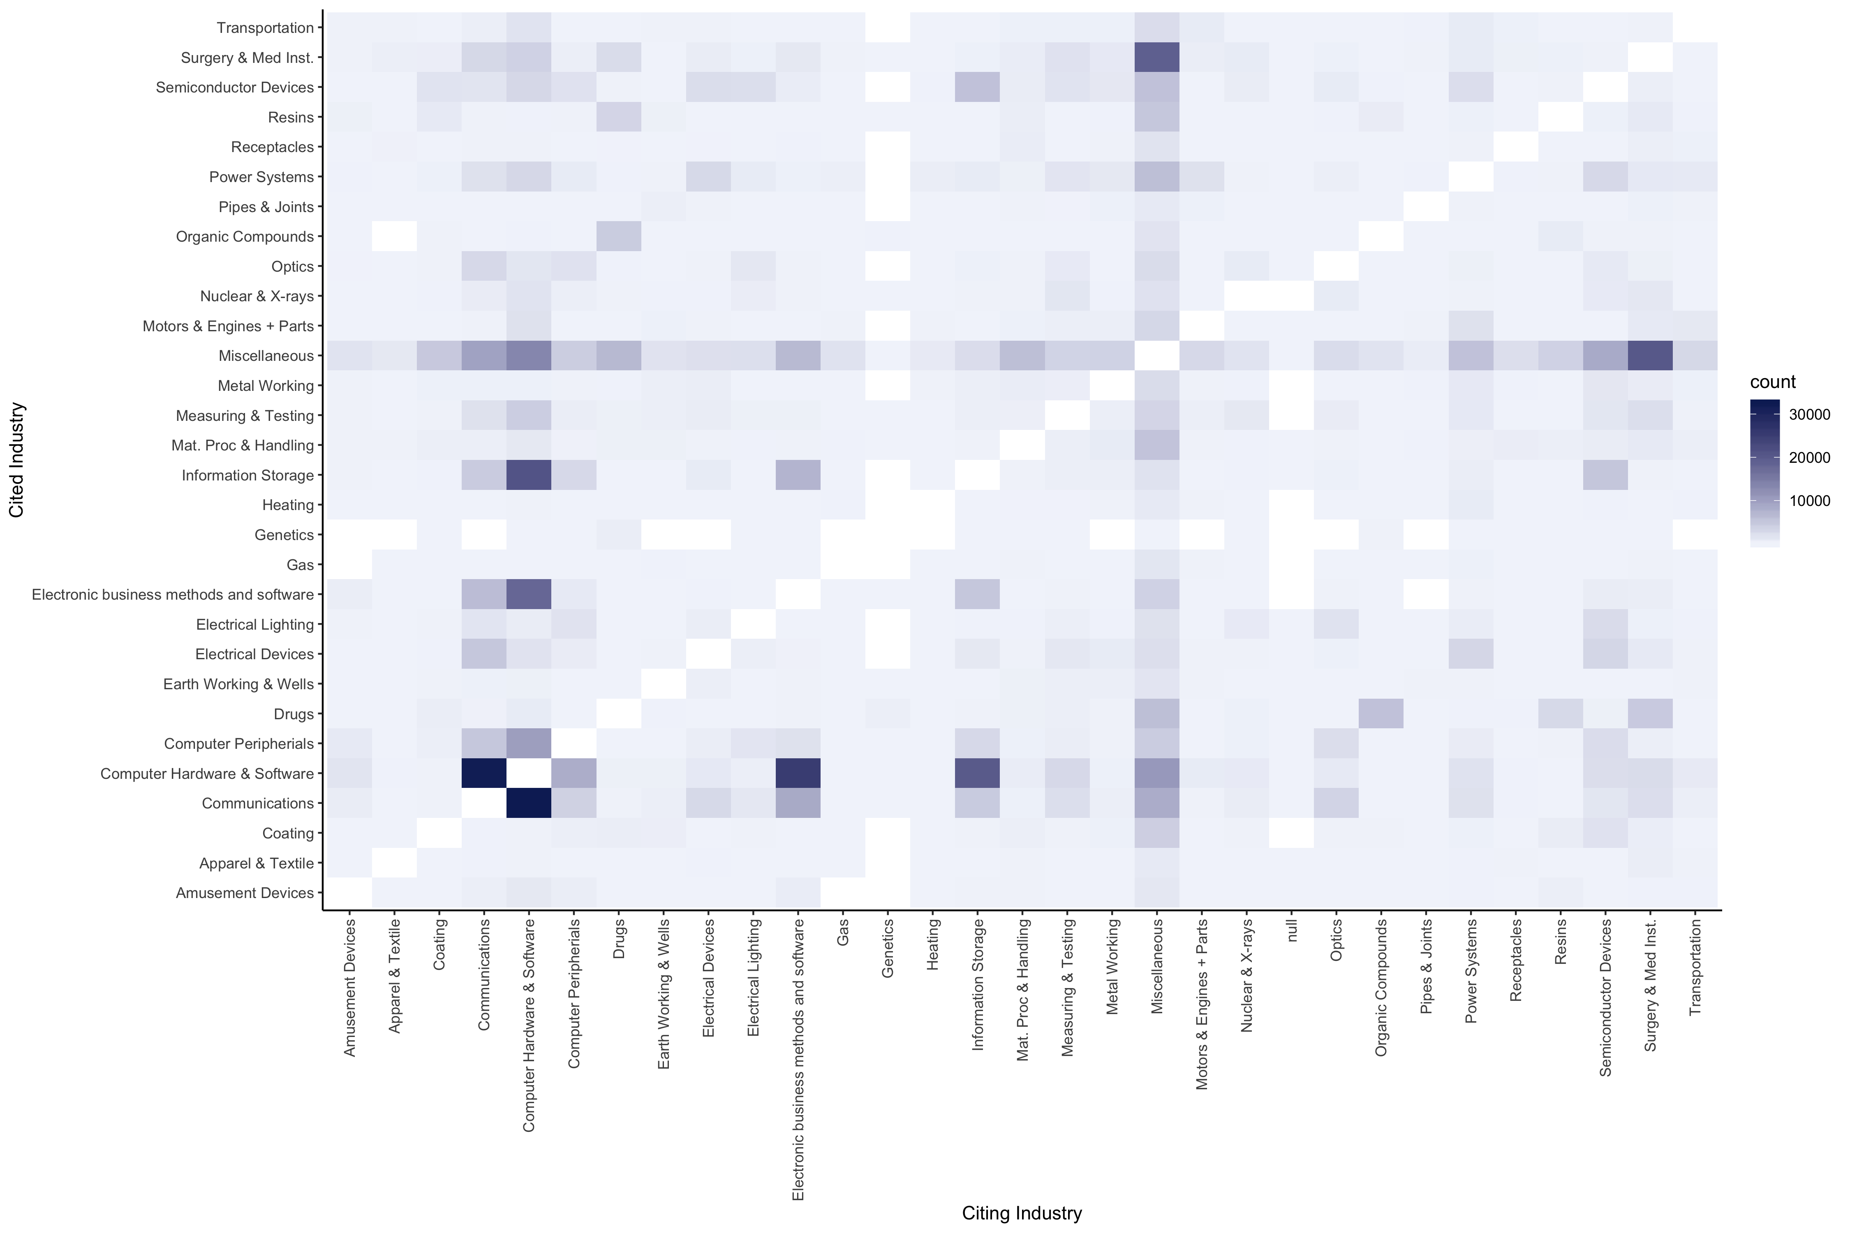
1976
Cross-Industry Citation Patterns
Plotted the cross-industry citations for five time periods
X axis: Citing industries
Y axis: Cited industries
Temporal axis: the period of time that the cited patent was created
Exclusion in the plots:
Patents citing other patents in the same industry
2016

Slide 16
Drugs Organic Compound
Computer Peripherials, Computer Hardware & Software, Communications

Slide 17
Take a closer look
1976-1980
Cited Industry
Drug industry patents became less likely to cite patents from the Organic Compounds industry, while the inverse remained consistent
An asymmetry in the beginning -> symmetry in the present day
1981-1990
1991-2000
2001-2010
2011-2016
Citing Industry

Slide 18
1976-1980
tech industries –
Computer Hardware & Software, Computer Peripherals,
Electronic Business Methods and Software, and Information Storage industries –
Have an increase of citations overall over time and have a rather symmetric interaction in between each of these industries
1981-1990
1991-2000
Cited Industry
2001-2010
2011-2016
Citing Industry

Slide 19
Utilizing Dijkstra Algorithm for the Shortest Path Detection

Slide 20
Finding the Shortest Path: Dijkstra
The Dijkstra Algorithm identifies the shortest path between nodes in a graph
We fix a single node as the "source" node and find shortest paths from the source to all other nodes in the graph, and produces a shortest-path tree

Slide 21
Dijkstra: Parallel Implementation
Data representation:
Key: node n
Value: d (distance from the source node), neighbor list (list of neighbor nodes from n)
Initialization: for all nodes except for the source node, d = infinity.
Mapper:
emit (m, d + 1 and neighbor list)
Reducer:
Group by reachable nodes
Selects minimum distance for each reachable node

Slide 22
Dijkstra: Parallel Implementation
If we want to find reachable neighbors within d distance, we need to implement the map-reduce for d times
The time complexity of a single iteration of the parallel Dijkstra is O(m+n), where m is the number of edges and n is the number of vertices
To find all nodes within distance d, the time complexity would be O(m+n) x O(b^{d} + 1), where b is the branching factor of the graph

Slide 23
Dijkstra Algorithm: Implementation
Algorithm implemented on Google Cloud for selected nodes
Maximum distance d set to 15

Slide 24
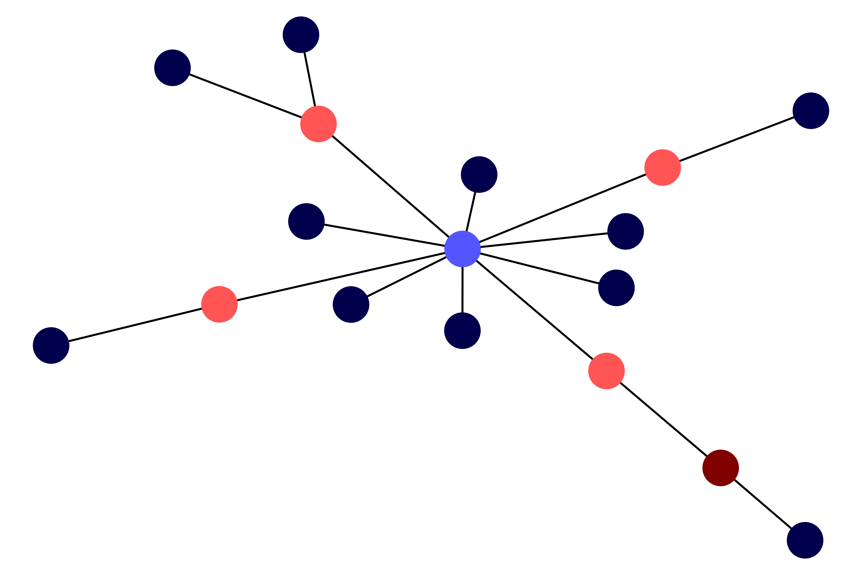
Visualization of Network Structure

Slide 25
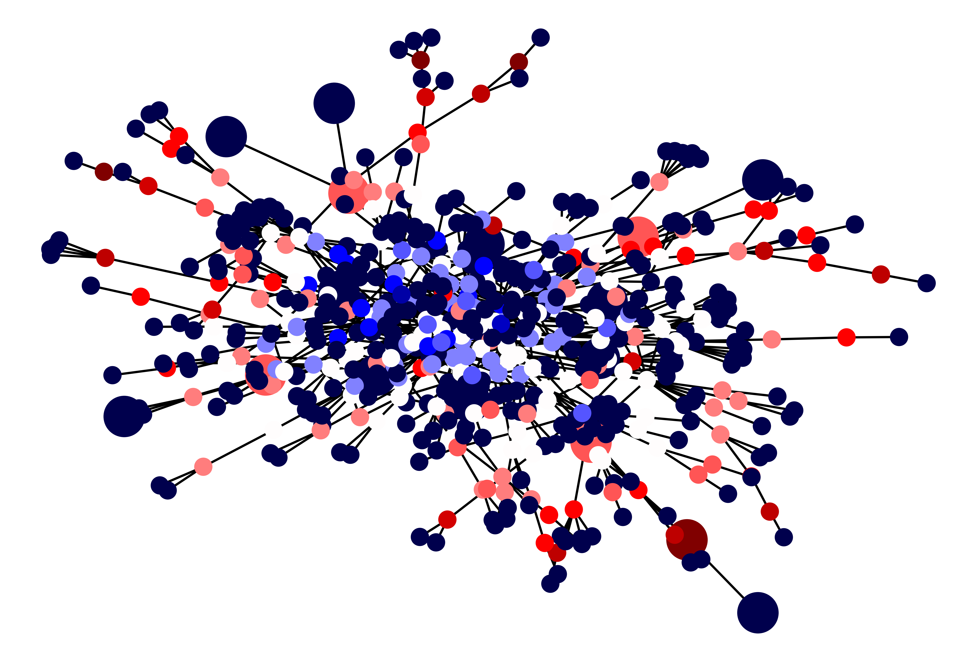
Visualization of Nodes

Slide 26
Resulting Limitations
With six million patents and 100 million total citations, we have a branching factor of about 16
Testing found that the merging process alone, with complexity O(nlog(n)), takes about four hours of work on GCS
With n = six million, and m = 100 million, a full solution is out of computational reach

Slide 27
Thanks!
ANY QUESTIONS?

